Slide 1
Digital Image Processing
Chapter 4: Filtering in the Frequency Domain

Slide 2
Background
The French mathematiian Jean Baptiste Joseph Fourier
Born in 1768
Published Fourier series in 1822
Fourier’s ideas were met with skepticism
Fourier series
Any periodical function can be expressed as the sum of sines and/or cosines of different frequencies, each multiplied by a different coefficient

Slide 3
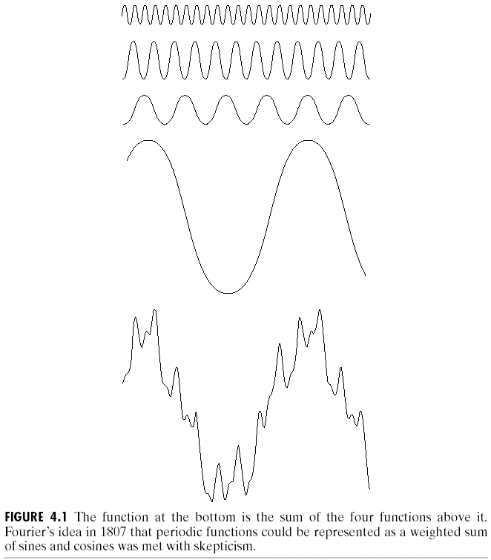

Slide 4
Fourier transform
Functions can be expressed as the integral of sines and/or cosines multiplied by a weighting function
Functions expressed in either a Fourier series or transform can be reconstructed completely via an inverse process with no loss of information

Slide 5
Applications
Heat diffusion
Fast Fourier transform (FFT) developed in the late 1950s

Slide 6
Preliminary Concepts
Complex numbers

Slide 7



Polar coordinates
Real part
Imaginary part

Slide 8
Magnitude or spectrum
Phase angle or phase spectrum
Power spectrum or spectral density

Slide 9
Fourier Series

Slide 10
Impulses and their sifting property

Slide 12
Impulse train

Slide 13
The Fourier transform of functions of one continuous variable
Fourier transform
Inverse Fourier transform

Slide 15







Slide 16
Convolution

Slide 17
Sampling and the Fourier Transform of Sampled Functions
Sampling

Slide 18











Slide 19












The Fourier transform of sampled functions

Slide 20
The sampling theorem

Slide 23
Ideal lowpass filter

Slide 24
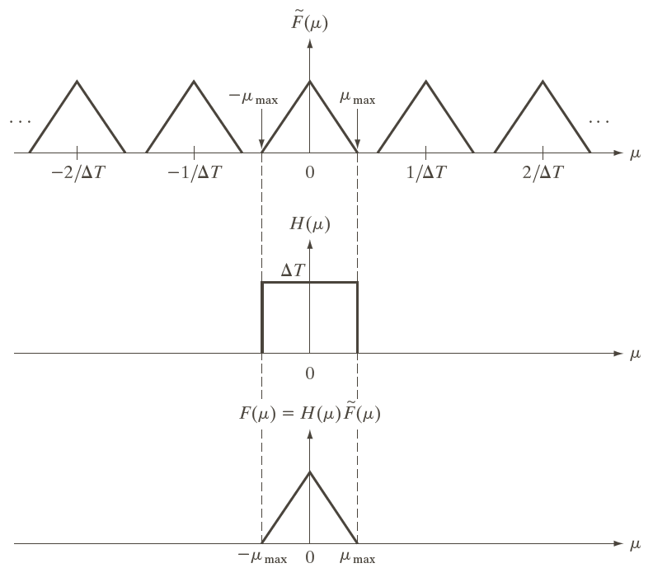

Slide 25
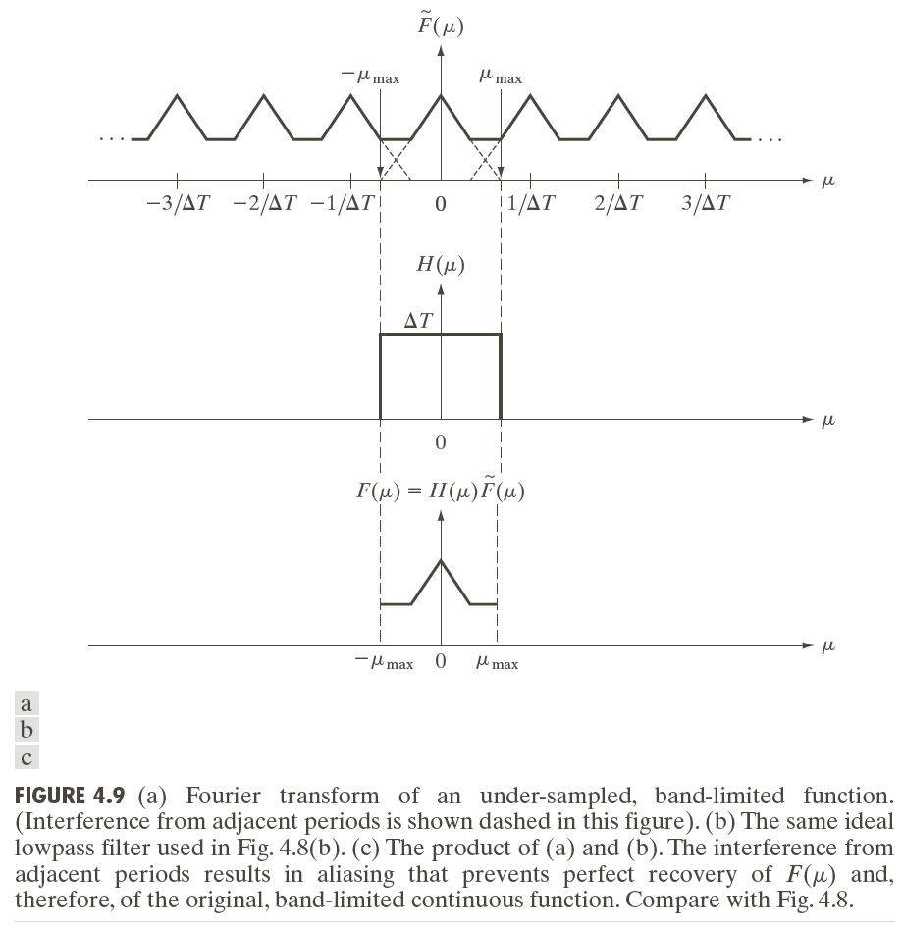
Aliasing

Slide 27
Function reconstruction from sampled data

Slide 28
The Discrete Fourier Transform (DFT) of One Variable

Slide 29
Period M
Circular convolution

Slide 30
Relationship between the sampling and frequency intervals

Slide 32
Extension to Functions of Two Variables
The 2-D impulse and its sifting property(篩選功能)

Slide 33
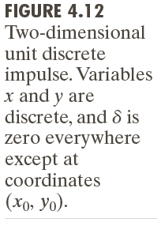

Slide 34
2-D discrete impulse

Slide 35
2-D continuous Fourier transform pair
Fourier transform
Inverse Fourier transform

Slide 36
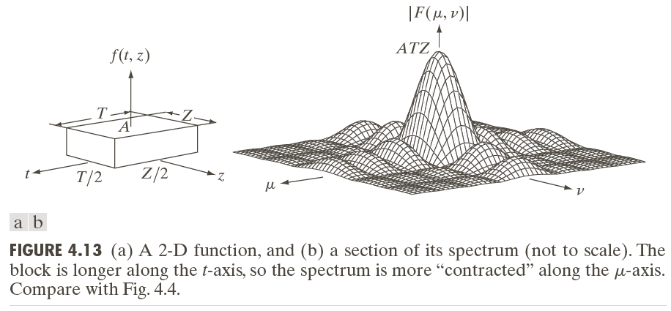






Slide 37
Two-dimensional sampling and the 2-D sampling theorem

Slide 38
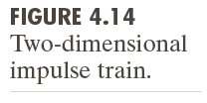

Slide 39
Band-limited
Recovered with no error if
and

Slide 40
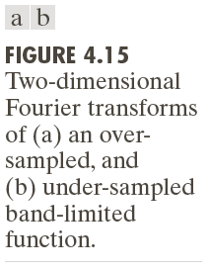
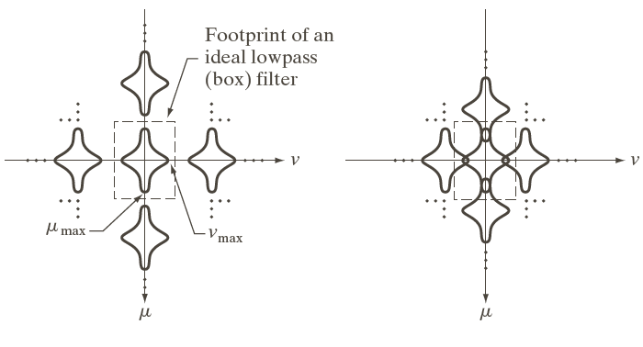
Aliasing in images

Slide 42
Image interpolation and resampling
Image shrinking: Under-sampling
Reduce aliasing: Blur an image slightly before shrinking it
Supersample the original scene and then reduce its size by row and column deletion

Slide 43
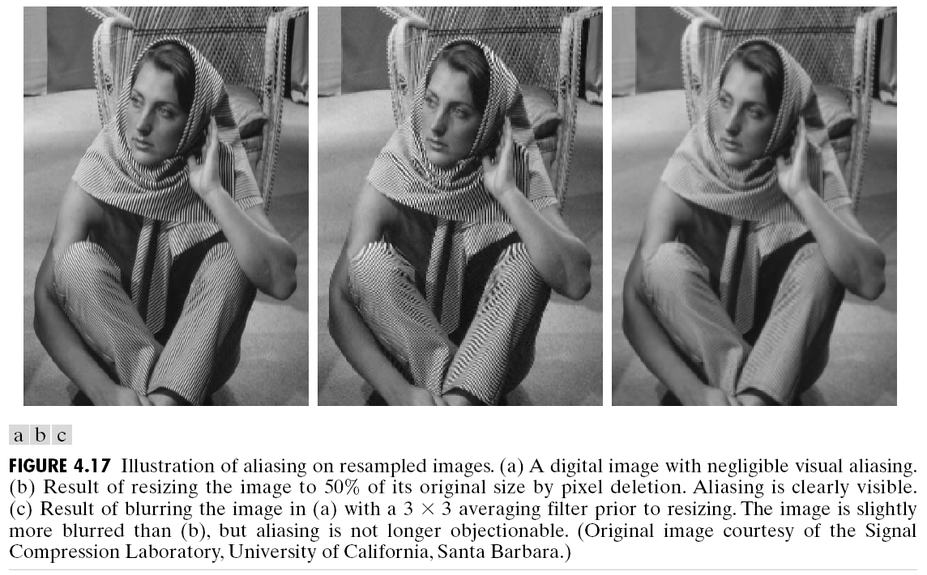


Slide 46
Moire patterns
Result from sampling scenes with periodic or nearly periodic components
Beat patterns produced between two gratings od approximately equal spacing

Slide 48


Slide 49
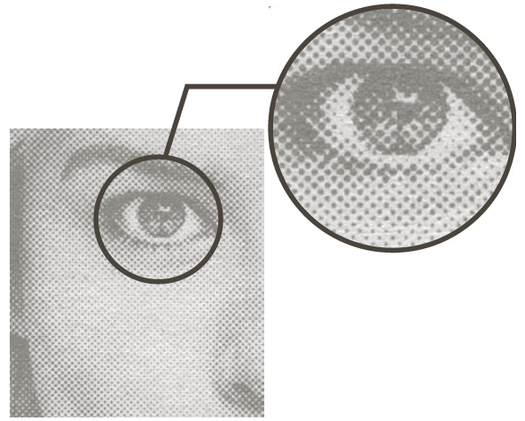

Slide 50
The two-dimensional DFT and its inverse

Slide 51
Spatial, or image variables: x, y
Transform, or frequency variables: u, v

Slide 52
Some Properties of the 2-D Discrete Fourier Transform
Relationships between spatial and frequency intervals

Slide 53
Translation
When and

Slide 56
Rotation
Polar coordinates
Rotating by an angle rotates by the same angle

Slide 57
Periodicity and conjugate symmetry
Periodicity property

Slide 58
Conjugate symmetry
Symmetry of the spectrum

Slide 60






Magnitude or spectrum
Phase angle or phase spectrum
Power spectrum or spectral density

Slide 61
Centering
Average gray level
F(0,0) is called the dc component of the spectrum

Slide 62
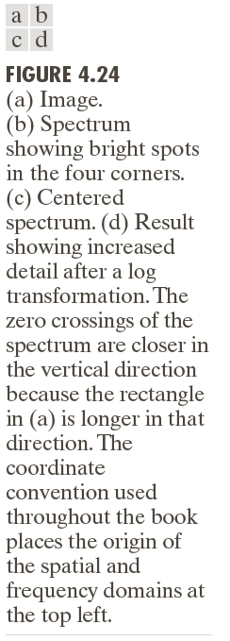

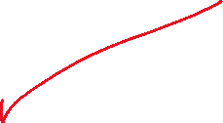

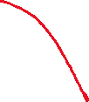







Slide 64



Slide 66
More on periodicity: the need for padding
Convolution: Flip one of the functions and slide it pass the other

Slide 67
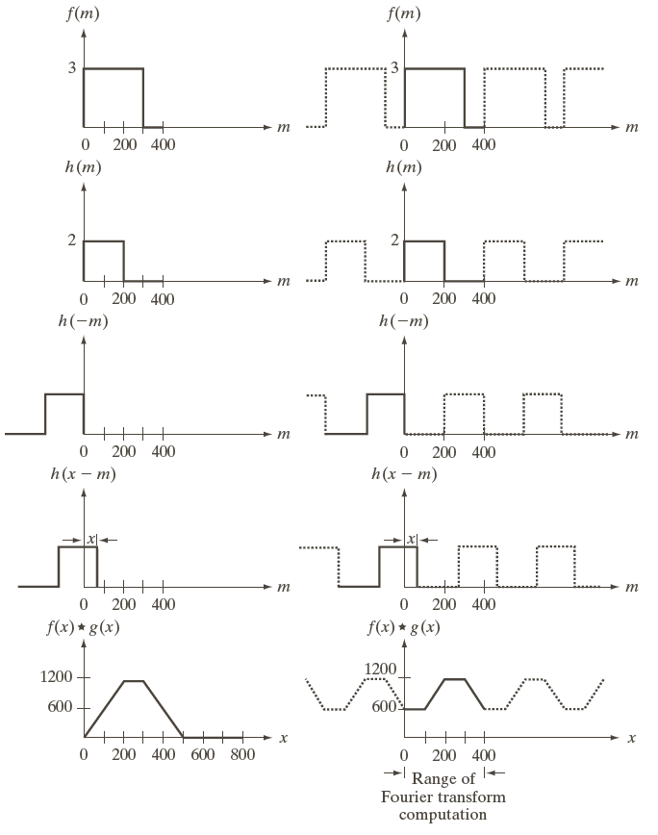

法1:回玄機
法1:做傅立葉轉換
(無窮多的複製)
失真:做padding

Slide 72
The Basics of Filtering in the Frequency Domain

Slide 73
Strong edges that run approximately at +45 degree, and -45 degree
The inclination off horizontal of the long white element is related to a vertical component that is off-axis slightly to the left
The zeros in the vertical frequency component correspond to the narrow vertical span of the oxide protrusions

Slide 74
Frequency domain filtering fundamentals

Slide 79
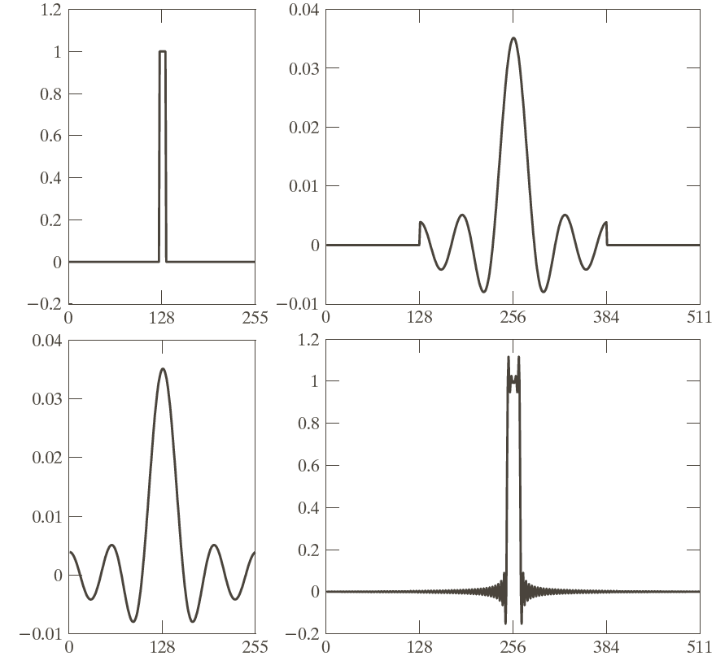

Slide 80
Zero-phase-shift filters

Slide 81
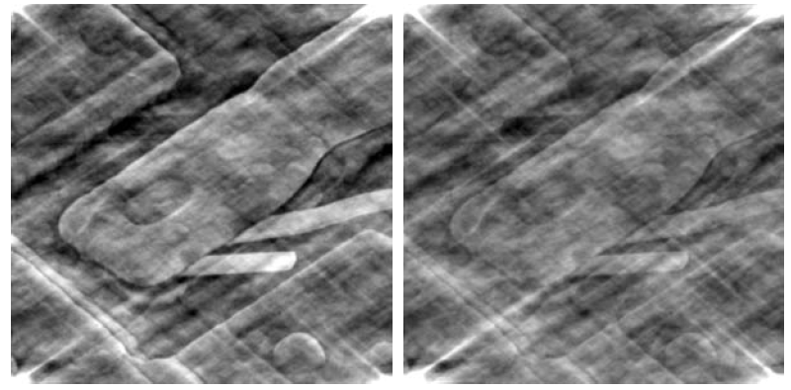

Slide 83
Summary of steps for filtering in the frequency domain
1. Obtain the padding parameters and . Typically and
2. Form a padded image, , of size
3. Multiply the input image by to center the transform

Slide 84
4. Compute F(u,v)
5. Generate a real, symmetric filter function, H(u,v), of size
with center at coordinates (P/2,Q/2).
6.
7. Obtain from

Slide 85
Correspondence between filtering in the spatial and frequency domains

Slide 86
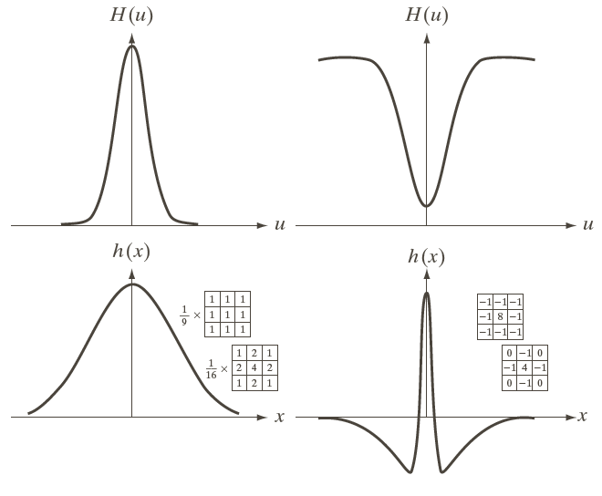

Slide 87
1-D frequency domain Gaussian filter:
Gaussian highpass filter:

Slide 88
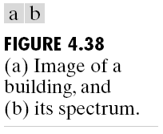

Slide 89
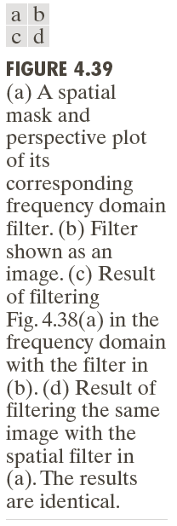

Slide 90
Grnerate
1. Multiply by
2. Compute the forward DFT
3. Set the real part of the DFT to 0
4. Multiply the result by

Slide 91
Image Smoothing Using Frequency Domain Filterers
Ideal lowpass filters

Slide 92
小於門檻值
大於門檻值

Slide 93
Cutoff frequency
Total image power
Portion of the total power

Slide 94
插入元行為10的元，超過部分直接濾掉，濾掉部分站元圖87%

Slide 96
Blurring and ringing properties(連波狀)
Filter
Convolution
: Spatial filter
was multiplied by
Then the inverse DFT
The real part of the inverse DFT was multiplied by

Slide 97
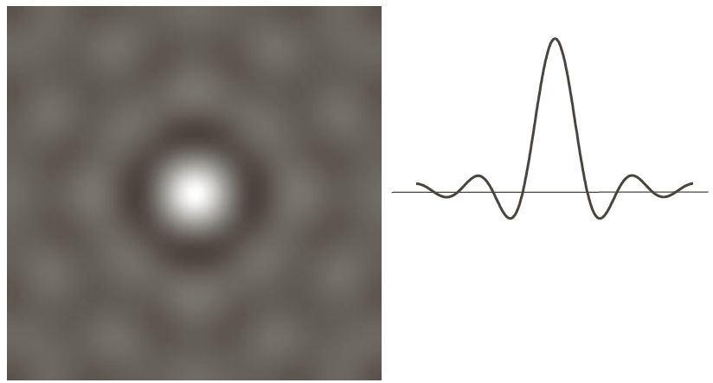

Slide 98
The filter
A dominant component at the origin
Concentric, circular components about the center component --- ringing
The radius of the center component and the number of circles per unit distance from the origin are inversely proportional to the value of the cutoff frequency of the ideal filter.圓半徑和截止頻率成反比

Slide 99
Butterworth lowpass filters
when

Slide 101
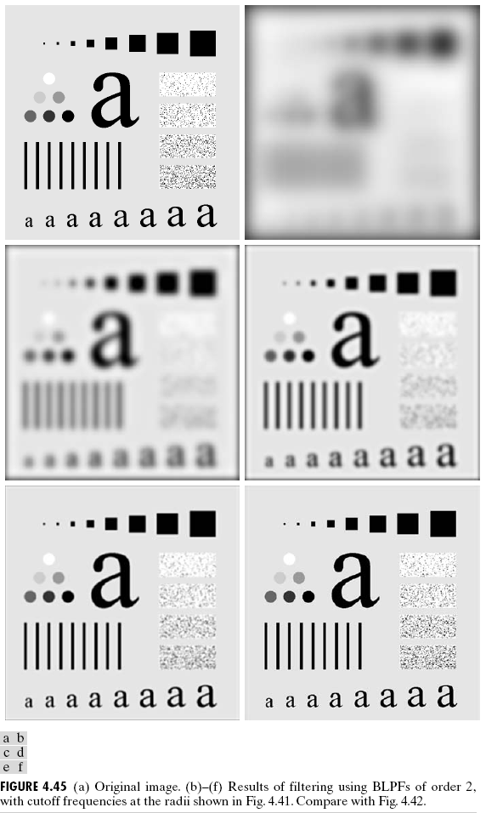

Slide 102
Butterworth lowpass filters
Order 1: No ringing
Order 2: Imperceptible ringing
Higher order: Ringing becomes a significant factor

Slide 103



Slide 104
Gaussain lowpass filters
When
No ringing

Slide 108
Additional examples of lowpass filters
Machine perception(感知
Printing and publishing
Satellite and aerial images

Slide 110
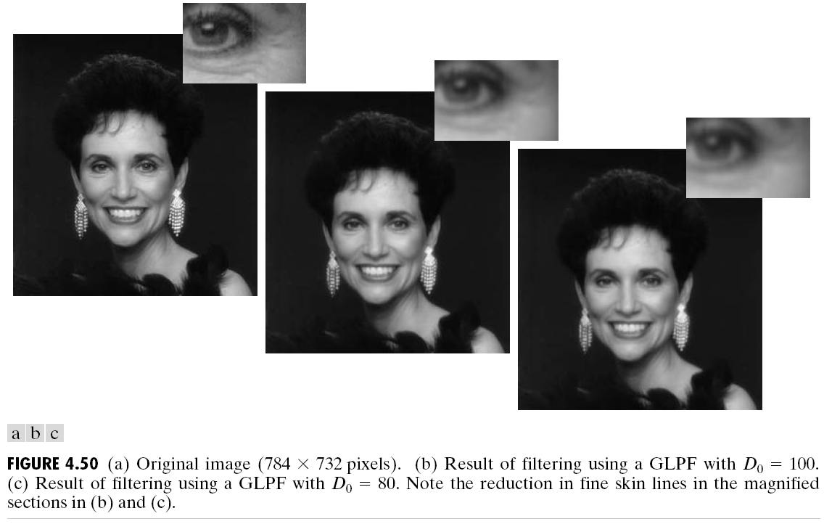

Slide 112
Image Sharpening Using Frequency Domain Filters
Highpass filter
Spatial filter:
was multiplied by
Then the inverse DFT
The real part of the inverse DFT was multiplied by

Slide 113
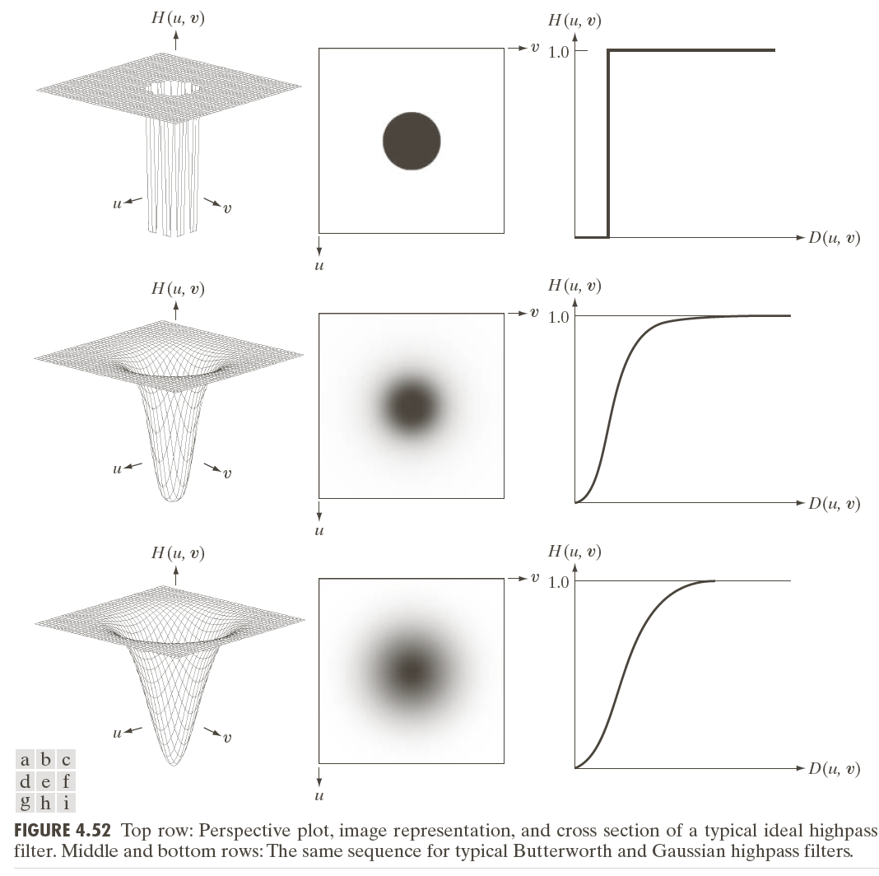

Slide 115
Ideal highpass filters

Slide 116
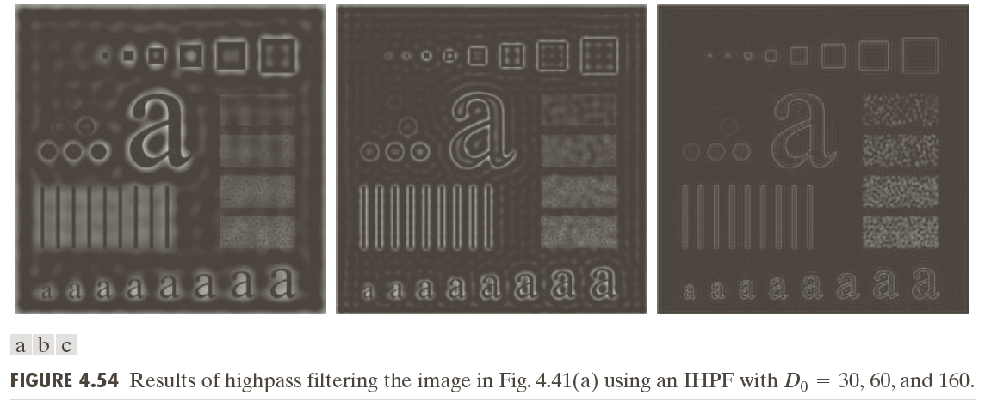

Slide 117
Butterworth highpass filters

Slide 118
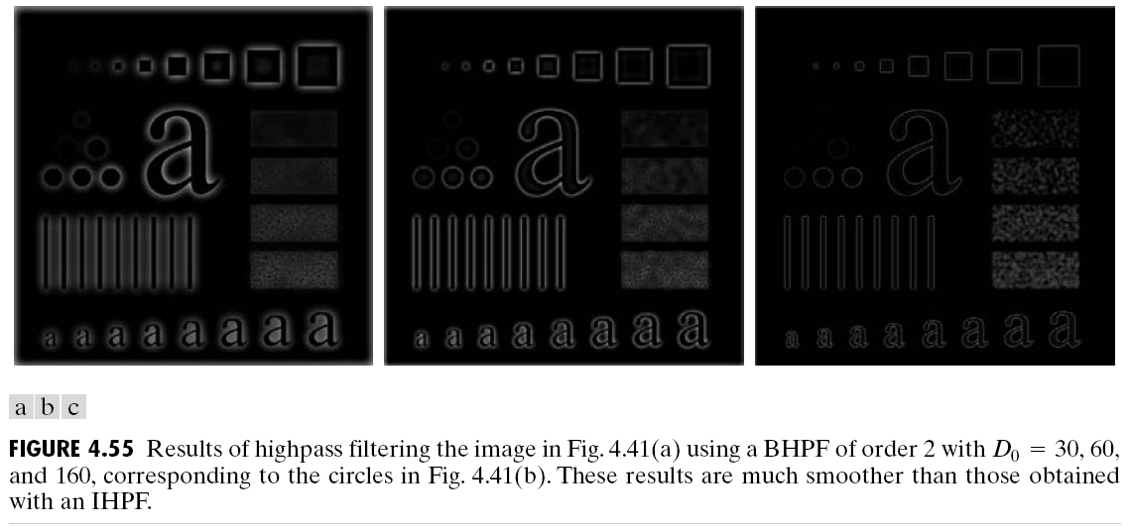

Slide 119
Gaussian highpass filters

Slide 120
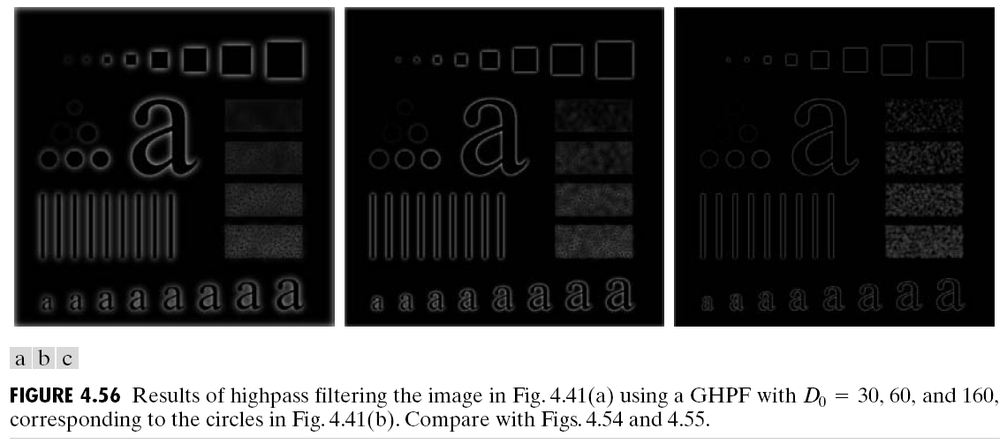

Slide 121
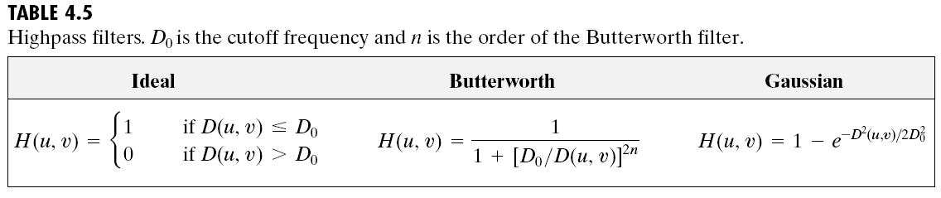

Slide 123
The Laplacian in the frequency domain

Slide 124
After centering

Slide 125
Inverse Fourier transform
Fourier-transform pair

Slide 126
Enhancement

Slide 127
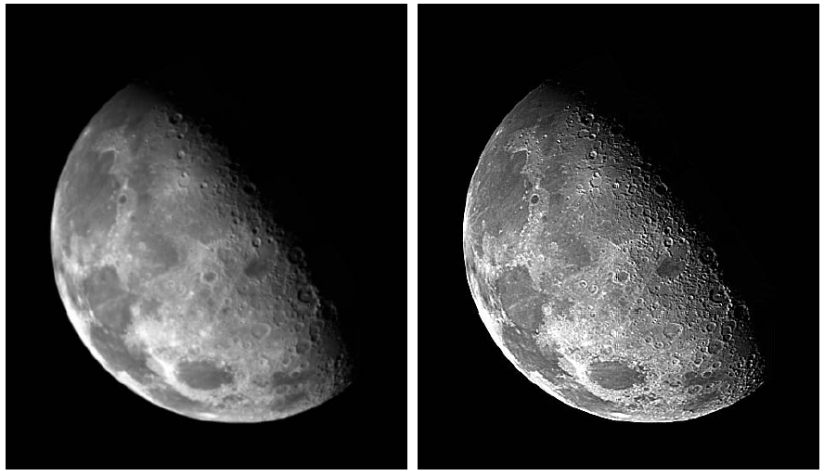

Slide 128
Unsharp masking, high-boost filtering, and high-frequency emphasis filtering
Mask

Slide 129
k=1, unsharp masking
K>1, highboost filters

Slide 131
Homomorphic Filtering
Illumination and reflectance components
Derivations

Slide 132
Or

Slide 133
Frequency domain
Spatial domain

Slide 134
原本取In，這裡要回去要取Exponential

Slide 135
Decrease the contribution made by the low frequencies (illumination)光源比重降低，明暗影響
Amplify the contribution made by high frequencies (reflectance)反射係數增加
Simultaneous dynamic range compression and contrast enhancement

Slide 136

二維環狀對稱函數
到中心距離

Slide 137
線條是高頻，會增強

Slide 138
Selective Filtering
Bandreject and bandpass filters

Slide 140
Notch filters

Slide 141
Butterworth notch reject filter

Slide 142
Notch pass filter

Slide 143

有4對(Q)雜訊

Slide 144
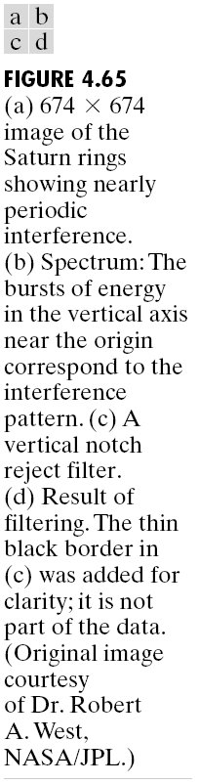


干擾(因為是重複出現的pattern，用fourier)
干擾在垂直線上

Slide 145


Slide 146
Implementation
Separability of the 2-D DFT

Slide 147
where
We can compute the 2-D transform by first computing a 1-D transform along each row of the input image, and then computing a 1-D transform along each column of this intermediate result

Slide 148
Computing the inverse Fourier transform using a forward transform algorithm

Slide 149
The fast Fourier transform (FFT)
Brute-force: summations and additions
FFT: Multiplications and additions

Slide 150
From: Discrete-Time Signal Processing, Second Edition, by Alan V. Oppenheim, Ronald W. Schafer, and John R. Buck, Prentice Hall, 1999.

Slide 154
Multiplications
Additions

Slide 155
Advantage

Slide 157
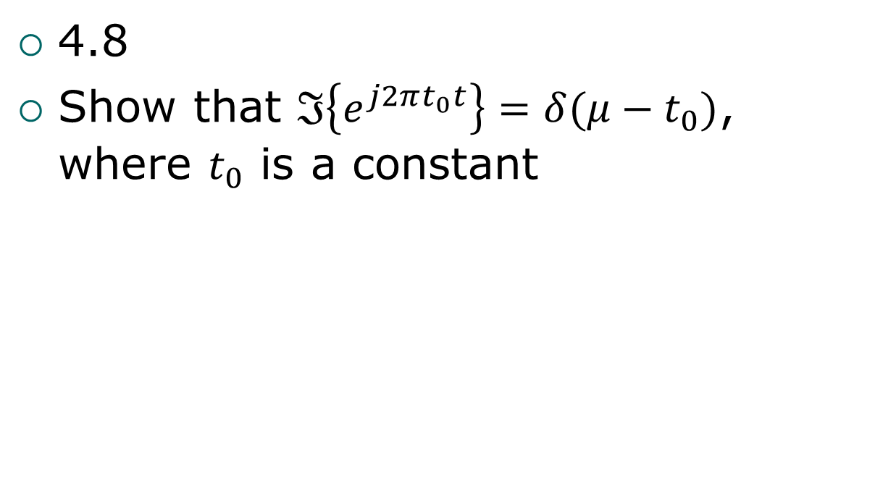
Problems
4.8
Show that $ℑ\left\{e^{j2πt_{0}t}\right\}=δ(μ−t_{0})$, where $t_{0}$ is a constant

Slide 158
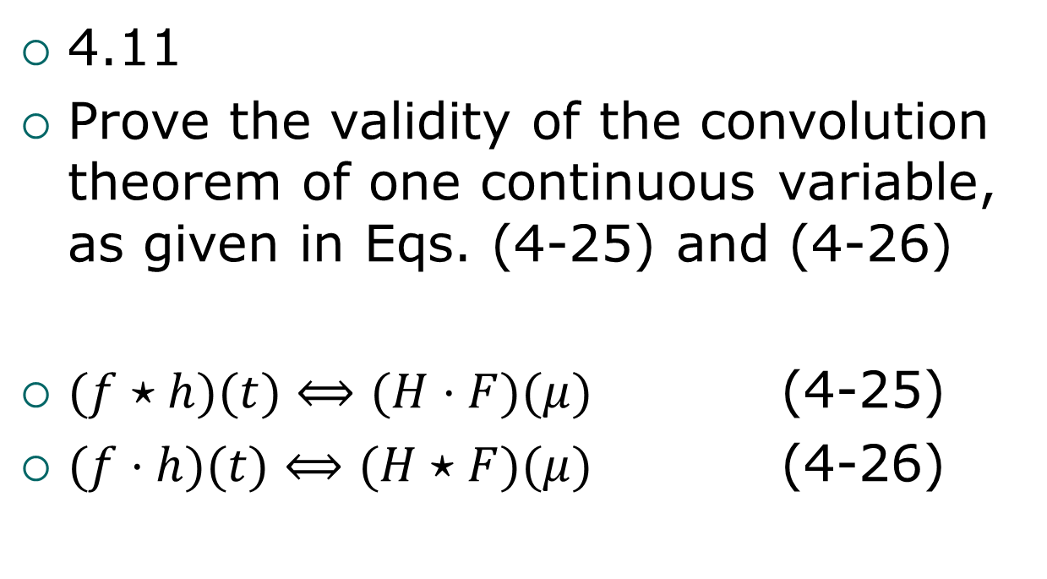
Problems
4.11
Prove the validity of the convolution theorem of one continuous variable, as given in Eqs. (4-25) and (4-26)
$(f⋆h)(t)⟺(H⋅F)(μ)$ (4-25)
$(f⋅h)(t)⟺(H⋆F)(μ)$ (4-26)

Slide 159
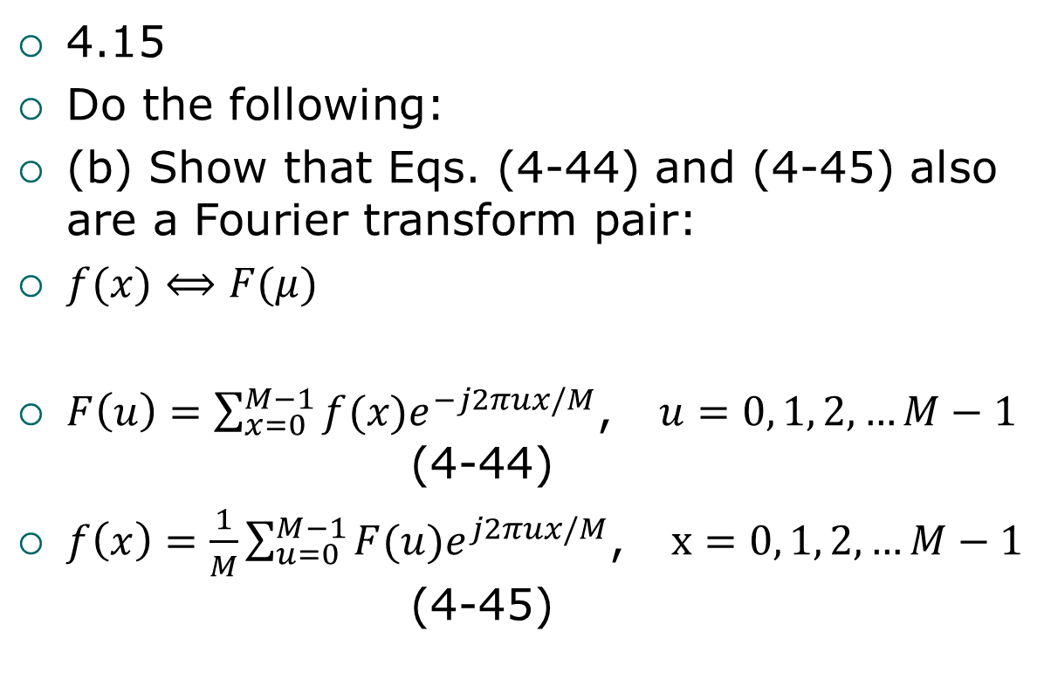
Problems
4.15
Do the following:
(b) Show that Eqs. (4-44) and (4-45) also are a Fourier transform pair:
$f(x)⟺F(μ)$
$F\left(u\right)=\sum_{x=0}^{M−1}{f(x)e^{−j2πux/M}}$, $u=0, 1, 2, …M−1$ (4-44)
$f\left(x\right)=\frac{1}{M}\sum_{u=0}^{M−1}{F(u)e^{j2πux/M}}$, $x=0, 1, 2, …M−1$ (4-45)

Slide 160
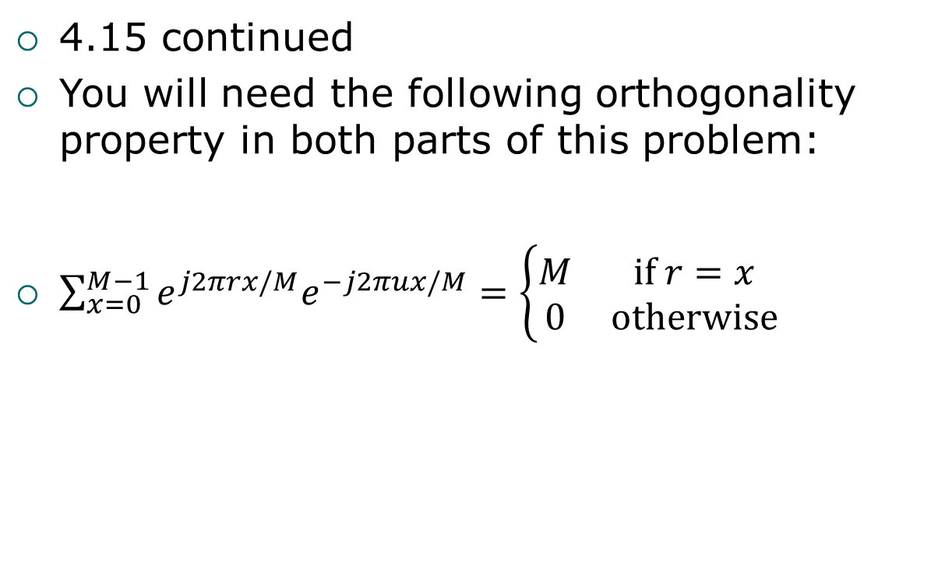
Problems
4.15 continued
You will need the following orthogonality property in both parts of this problem:
$\sum_{x=0}^{M−1}{e^{j2πrx/M}e^{−j2πux/M}}=\left\{\begin{matrix}M & if r=x \\ 0 & otherwise\end{matrix}\right.$

Slide 161
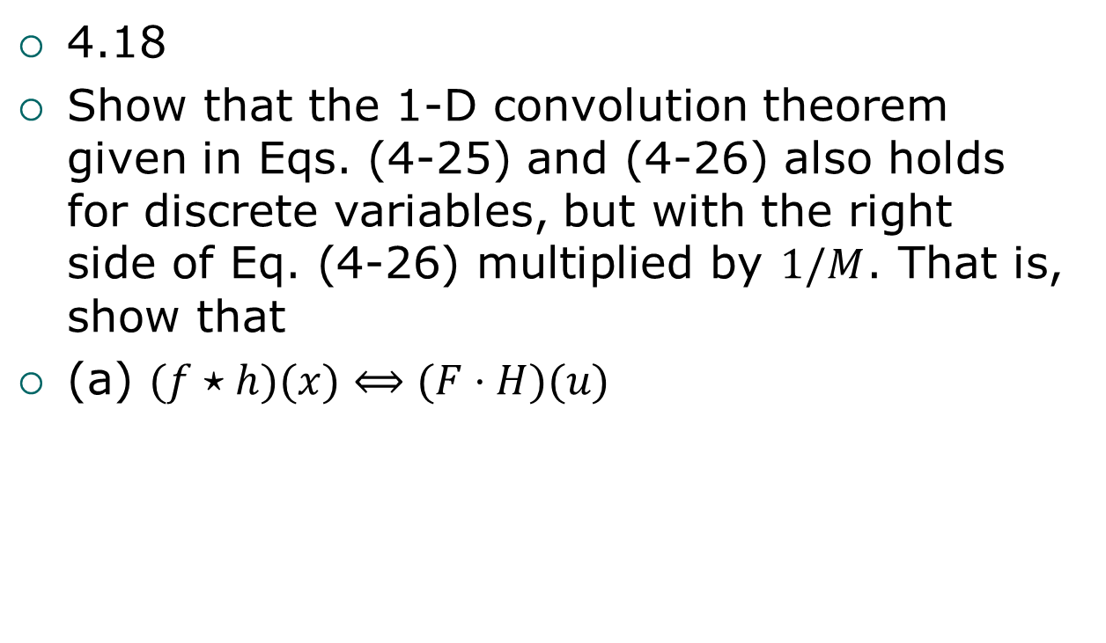
Problems
4.18
Show that the 1-D convolution theorem given in Eqs. (4-25) and (4-26) also holds for discrete variables, but with the right side of Eq. (4-26) multiplied by $1/M$. That is, show that
(a) $(f⋆h)(x)⟺(F⋅H)(u)$

Slide 162
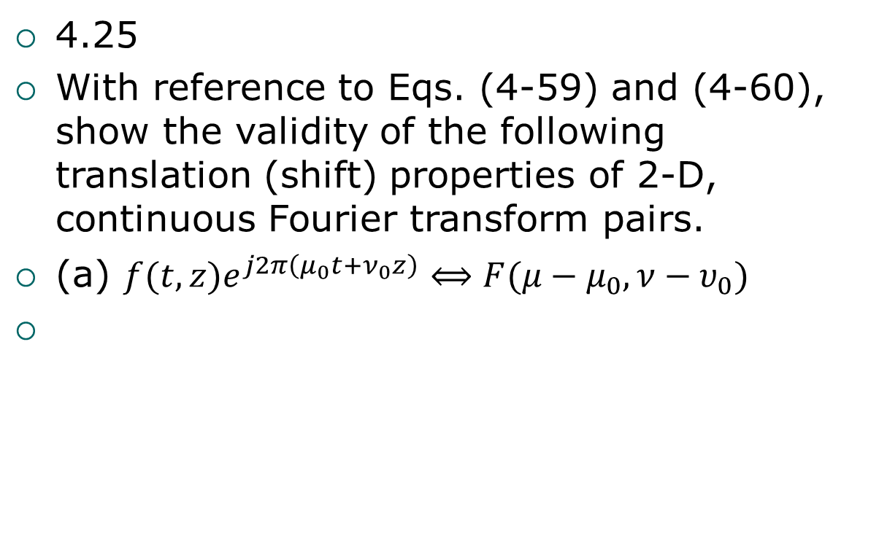
Problems
4.25
With reference to Eqs. (4-59) and (4-60), show the validity of the following translation (shift) properties of 2-D, continuous Fourier transform pairs.
(a) $f(t,z)e^{j2π\left(μ_{0}t+ν_{0}z\right)}⟺F(μ−μ_{0},ν−υ_{0})$

Slide 163
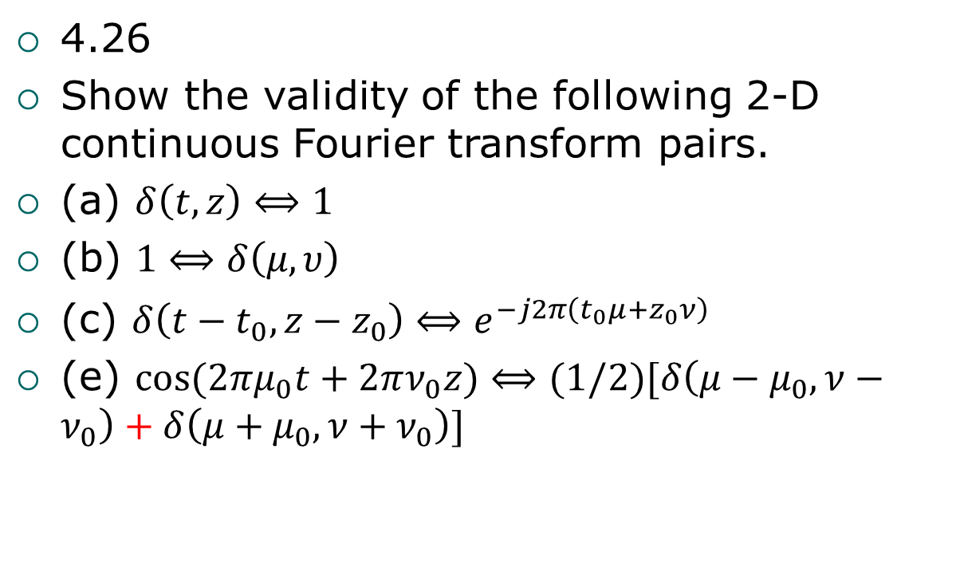
Problems
4.26
Show the validity of the following 2-D continuous Fourier transform pairs.
(a) $δ\left(t,z\right)⟺1$
(b) $1⟺δ\left(μ,υ\right)$
(c) $δ\left(t−t_{0}, z−z_{0}\right)⟺e^{−j2π\left(t_{0}μ+z_{0}ν\right)}$
(e) $\cos{(2πμ_{0}t+2πν_{0}z)}⟺(1/2)[δ\left(μ−μ_{0},ν−ν_{0}\right)+δ\left(μ+μ_{0},ν+ν_{0}\right)]$

Slide 164
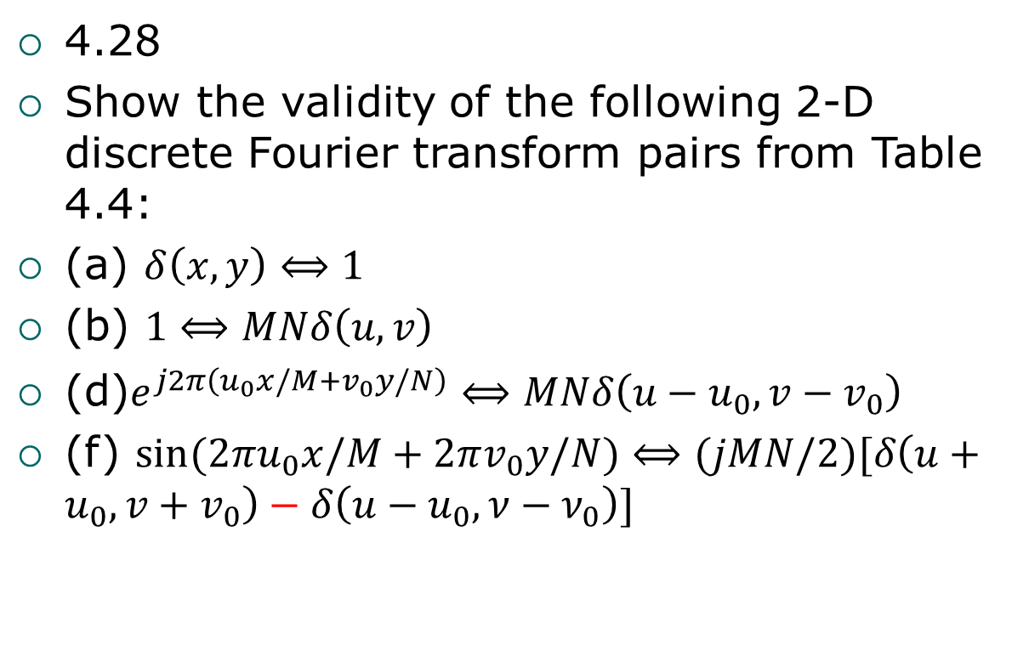
Problems
4.28
Show the validity of the following 2-D discrete Fourier transform pairs from Table 4.4:
(a) $δ\left(x,y\right)⟺1$
(b) $1⟺MNδ\left(u,v\right)$
(d)$e^{j2π\left(u_{0}x/M+v_{0}y/N\right)}⟺MNδ\left(u−u_{0}, v−v_{0}\right)$
(f) $\sin{(2πu_{0}x/M+2πv_{0}y/N)}⟺(jMN/2)[δ\left(u+u_{0},v+v_{0}\right)−δ\left(u−u_{0},ν−ν_{0}\right)]$

Slide 165
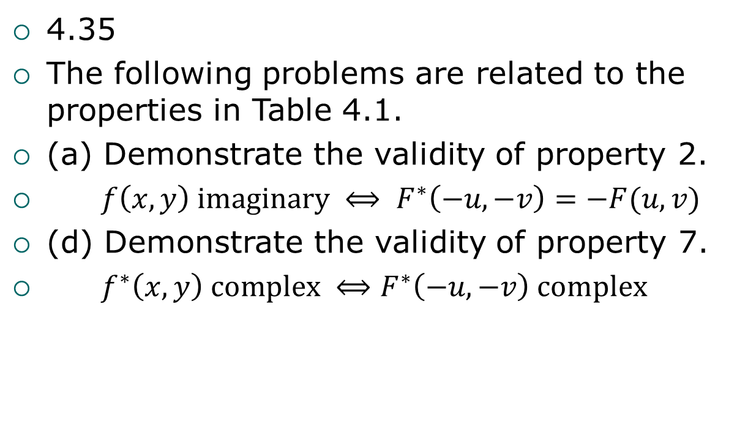
Problems
4.35
The following problems are related to the properties in Table 4.1.
(a) Demonstrate the validity of property 2.
$f\left(x, y\right) imaginary ⟺ F^{∗}\left(−u, −v\right)=−F(u, v)$
(d) Demonstrate the validity of property 7.
$f^{∗}\left(x, y\right) complex ⟺F^{∗}\left(−u, −v\right) complex$

Slide 166
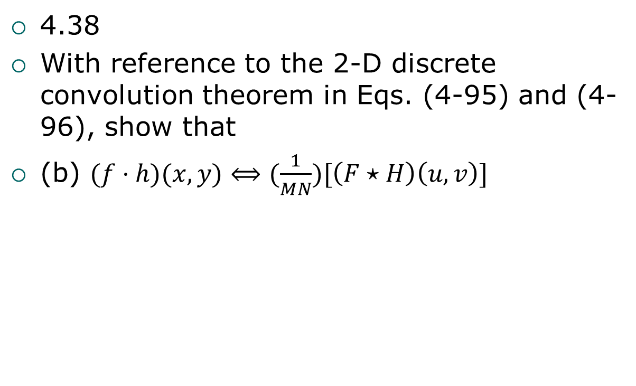
Problems
4.38
With reference to the 2-D discrete convolution theorem in Eqs. (4-95) and (4-96), show that
(b) $(f⋅h)(x, y)⟺(\frac{1}{MN})[\left(F⋆H\right)\left(u,v\right)]$

Slide 167
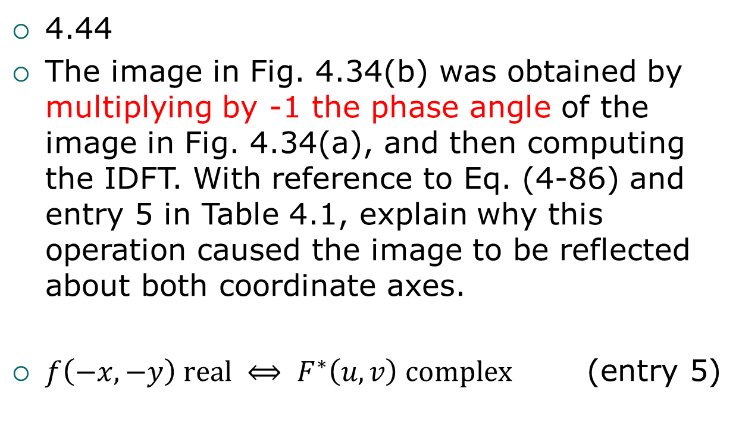
Problems(pdf:p269)
4.44
The image in Fig. 4.34(b) was obtained by multiplying by -1 the phase angle of the image in Fig. 4.34(a), and then computing the IDFT. With reference to Eq. (4-86) and entry 5 in Table 4.1, explain why this operation caused the image to be reflected about both coordinate axes.
$f\left(−x, −y\right) real ⟺ F^{∗}\left(u, v\right) complex$ (entry 5)

Slide 168
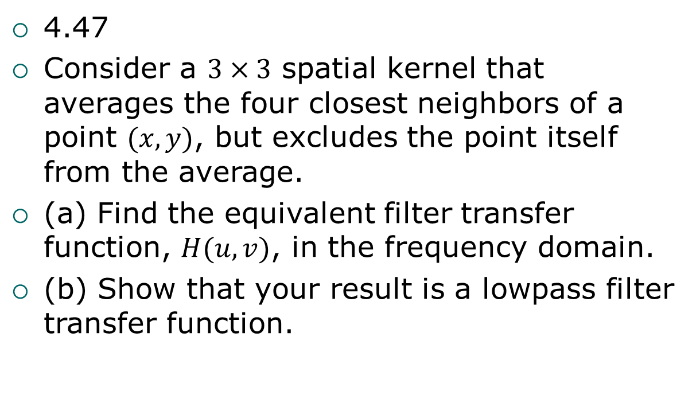
Problems
4.47
Consider a $3×3$ spatial kernel that averages the four closest neighbors of a point $(x, y)$, but excludes the point itself from the average.
(a) Find the equivalent filter transfer function, $H(u, v)$, in the frequency domain.
(b) Show that your result is a lowpass filter transfer function.

Slide 169
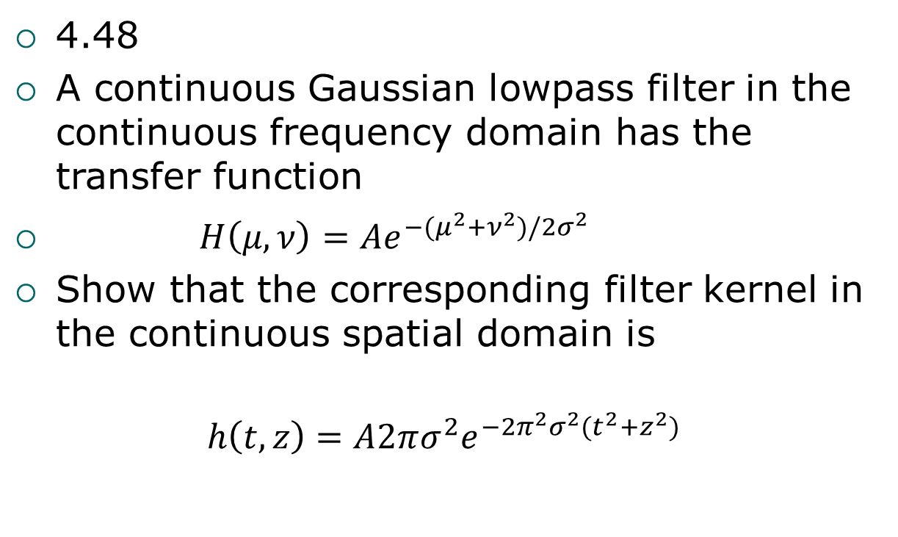
Problems
4.48
A continuous Gaussian lowpass filter in the continuous frequency domain has the transfer function
$H\left(μ,ν\right)=Ae^{−(μ^{2}+ν^{2})/2σ^{2}}$
Show that the corresponding filter kernel in the continuous spatial domain is
$$h\left(t,z\right)=A2πσ^{2}e^{−2π^{2}σ^{2}(t^{2}+z^{2})}$$

Slide 170
Problems
4.56
Show how the Butterworth highpass filter transfer function in Eq. (4-121) follows from its lowpass counterpart in Eq. (4-117)

